Slide 1

ASOIU
Topic 2
Hasanova Jamila

Slide 2
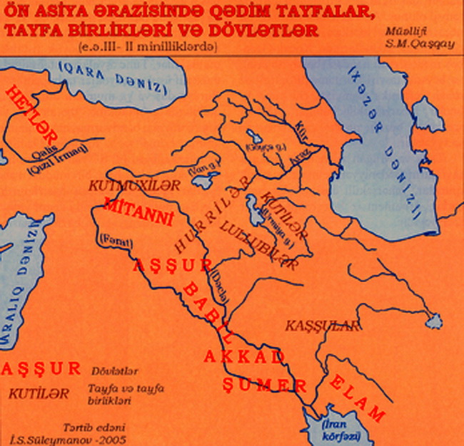

Slide 3
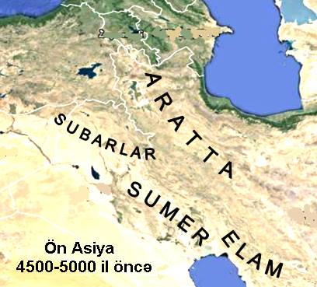

Slide 4
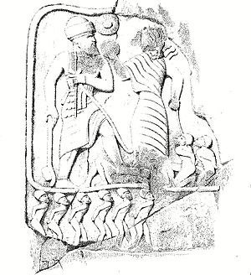
The monument to Anubani's victory

Slide 5
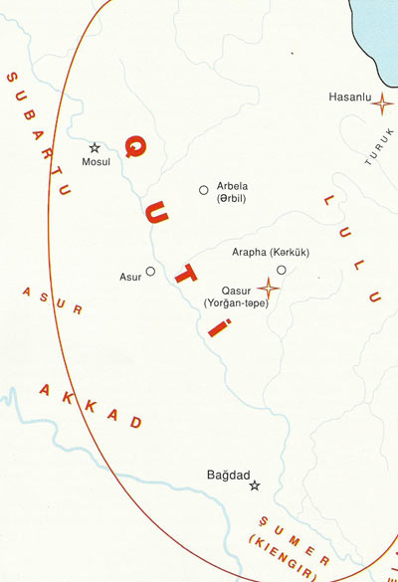
Kuti State

Slide 6
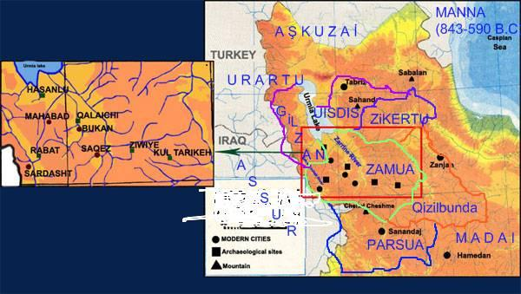
The state of Manna

Slide 7
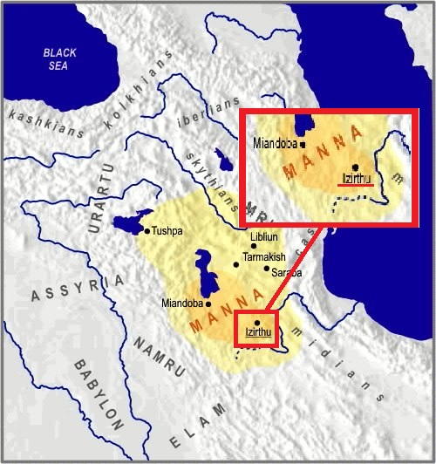

Slide 8
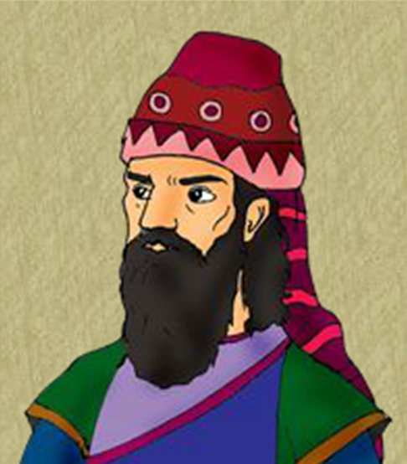
The ruler of Manna, Iranzu (740 BC)

Slide 9
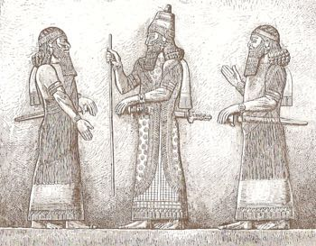
The purpose of II Sargon III's march
1) Release Manna from the aggression of the Urartu state
2) Strengthen Assyria's position in Manna
3) Receive Manna from time to time
The Assyrian ruler
II Sargon
(770 BC - 705 BC)

Slide 10
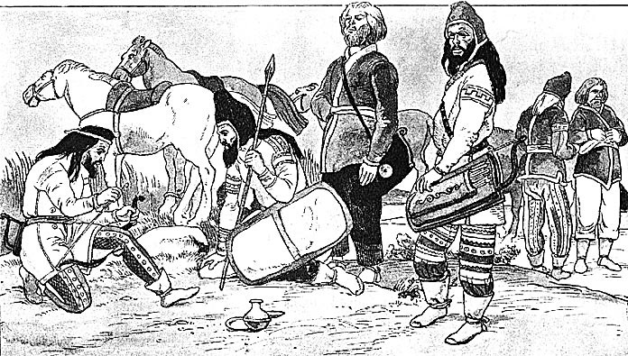
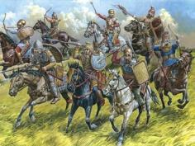
Chimeras (Kimmers)
Scythians (skifis)

Slide 11
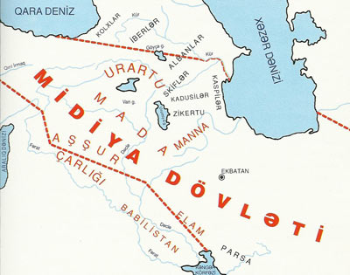
The state of the Media

Slide 12
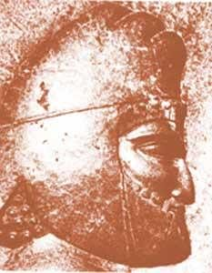
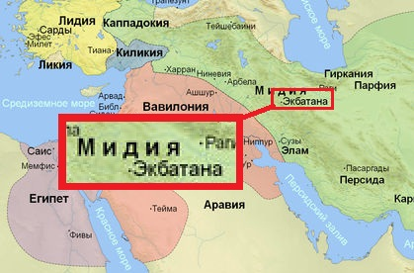
Kiaxar, the ruler of Media

Slide 13
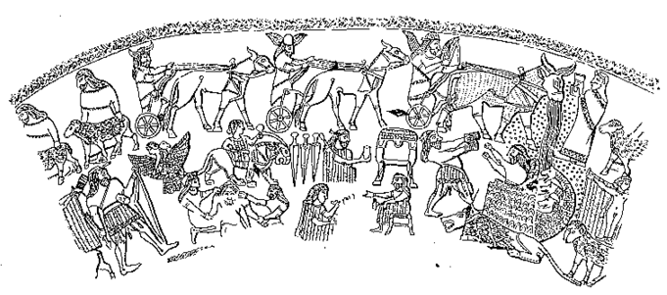
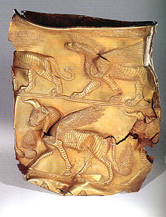
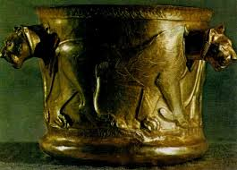
Culture

Slide 14
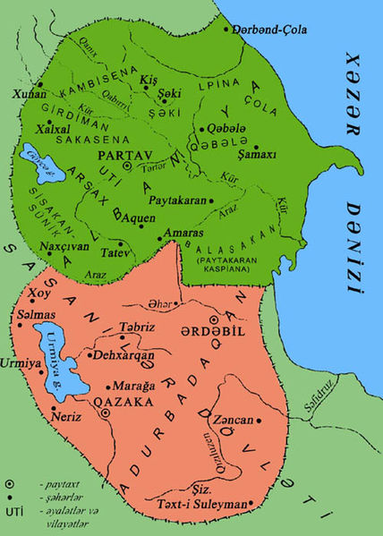
Ancient countries in the territory of Azerbaijan

Slide 15
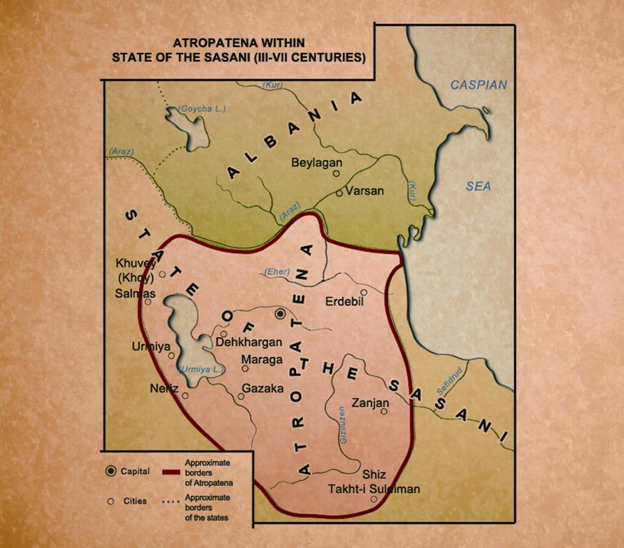
After the death of Alexander the great in 323bc his created empire got shattered into separate states. At that time there arose the state of Atropatena in the south and state of Albania in the north of Azerbaijan. Atropat was the first king of Atropatena .the creation of a geographical name of “Azerbaijan” is connected with Atropatena . Qazaka was the capital city of Atropatena and it was situated on the south-east of lake Urmiya.

Slide 16
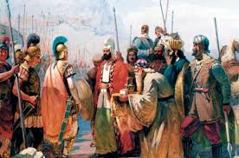
Battle
Antiochus III (223-187 BC) came to power in the State of Seleucids. He attacked Atropatena in 223 BC and won. As a result ,Artabazan –the king of Atropatena became dependent on the Seleucids. However military success of the Seleucids continued a short while. Rome was trying to spread its dominance in the eastern contries. Romans defeated Antiochus III at the battle of Magnesia in 190 BC. The State of Atropatena became independent again.

Slide 17

The state symbol of the state of Atropatena

Slide 18
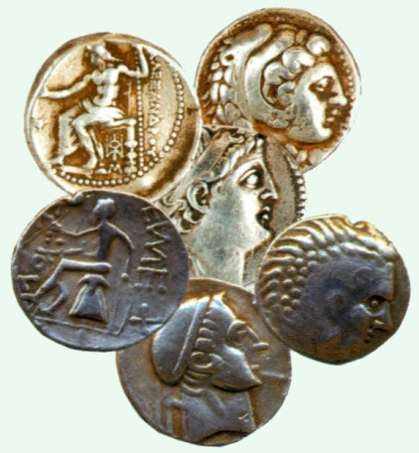
Money coined during Atropatena and Albania

Slide 19
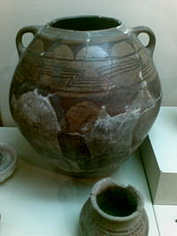
Paint containers found in the Atropatena area

Slide 20
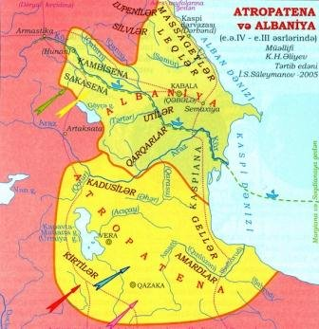
State of Albania

Slide 21
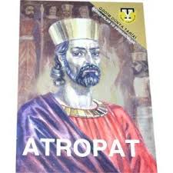
0ne 0f the main temples of Zoroastrianism was located in qazaka, the capital city of atropatena.this temple retained it is importance dissemination of islam. Nowdays, the number of believers 0f this religion reaches 130 thousand.the atropatena people believer zardush relagion.their book was avesta.

Slide 22
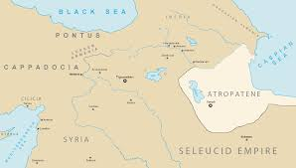
`Midian oil`
The population was engaged in various sectors of the economy. Agriculture , gardening and viticulture developed in the river valleys and around Lake Urmiya. Cattle - breeding developed in the mountainous areas of the country . There also were oil fields in Atropatena .They extracted oil fields in Atropatena . The oil was called `Midian oil` and was used for military purpose.

Slide 23
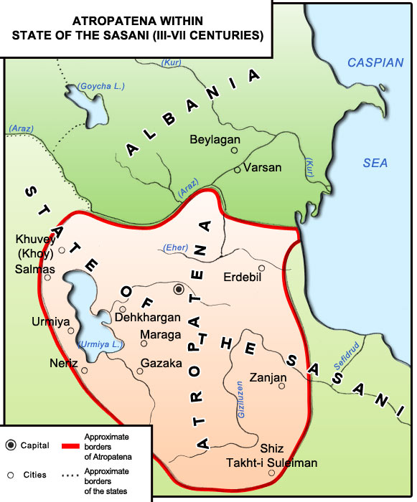
The Establishment of Albania
After the death of Alexander the Great in 323 B.C., his created empire got shattered into separate states. State of Atropatena in the South and State of Albania in the North of Azerbaijan.
The independent state of Albania was established at the end of IV- beginning of III centuries B.C. The Albanians lived in the territory, located between Iberia and the Caspian Sea.
In the I century Albania was ruled by local rulers. In the III century brave Vachagan I, the Albanian Arshakid representative, turned Albania in a single powerful state combining all its refions. Capital of the Albania was Qabala.

Slide 24
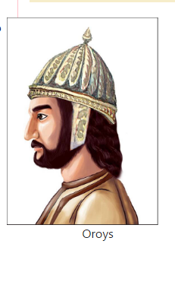
Rome turned into the most powerful state and under the leadership of the warlord Lucullus the Roman troops moved eastward, thus creating a danger for the South Caucasus in the II century. The Roman warlord Pompey decided to attack Albania and Iberia. The Romans wanted to capture the Caspian sea coast and trade route linking India with the Black sea coasts and passing through Albania. As the temperature fell Pompey decided to spend the winter in the valley of the Kur. Oroys – the king of Albania decided to attack the camp of the Romans crossing the Kur.
There was a bloody battle on the bank of river Kur in December 66 B.C. Pompey made the peace with the Albanians. Chasing the Romans the Albanians had created a dangerous situation for them. That’s why Pompey marched against the Albanians again in 65 B.C.
In 260 Shapur Ist (241- 272) the king of Sasanids defeat the Roman army. The Roman emperator Valerian was captured. Albanian’s ruler Vache Ist (255- 262) preffered the union with Rome than obeying Sassanids.

Slide 25
Feudal relations in Albania the period of Sassanid’s
Feudal relations
Taxs
Priest – Don’t give any tax
Warriors – Don’t give any tax
Clerks – Don’t give any tax
Tax players – give very hard taxs . Gezit and xarat
Gezid – life tax
Xarat – land tax

